Slide 1
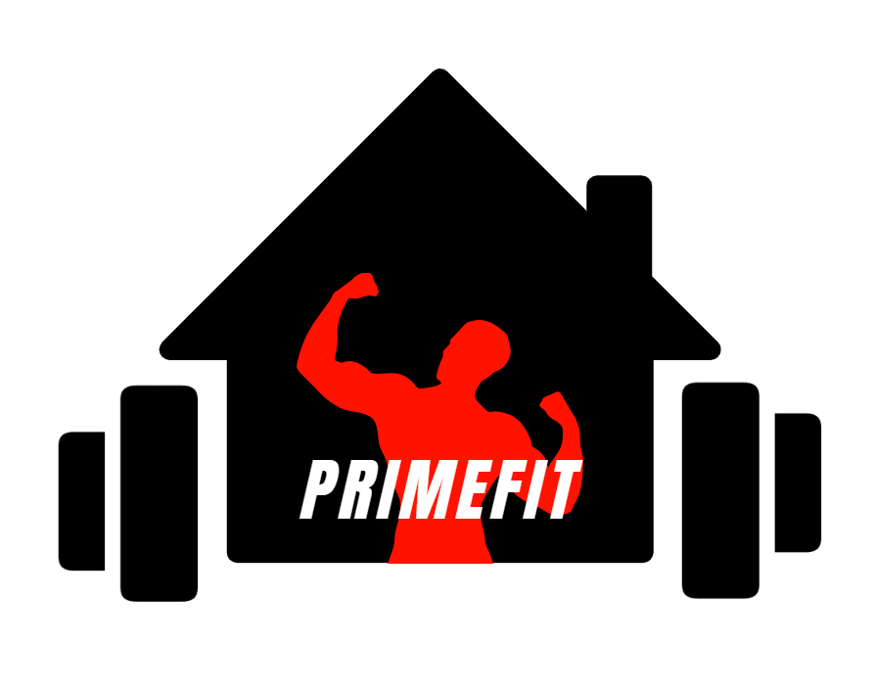
PrimeFit: The Future of Home Fitness
A Subscription-Based Fitness Revolution

Slide 2
Introduction to PrimeFit
The problem(The Conventional Gym):
gym inconvenience
time constraints
PrimeFit Solution:
subscription-based home fitness
What we provide
Equipment
Training
Fitness Articles, Workout Videos, and so much more
All in One Place!

Slide 3
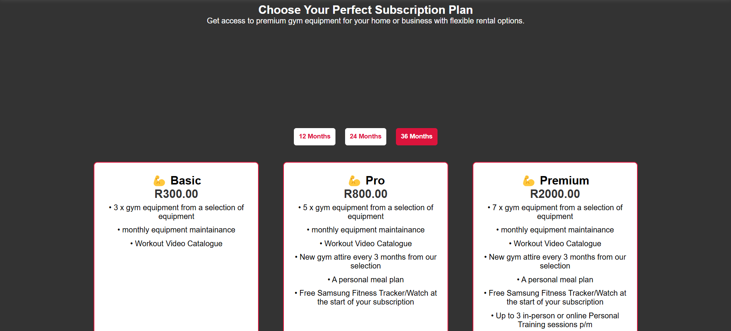
Subscription Plans

Slide 4
User Stories:
Real-World Impact

Slide 5

Thabo Mokoena (32) – The Busy Professional
📍 Location: Sandton, Johannesburg 🏢 Occupation: Investment Banker 💪 Fitness Goal: Stay fit despite long work hours
Story:
Thabo has always valued his health, but with his demanding job in Johannesburg’s financial district, making it to the gym is a struggle. Between client meetings, late-night work sessions, and Joburg traffic, he finds himself skipping workouts more often than not.
When he sees an ad for PrimeFit, he’s intrigued by the idea of having gym equipment delivered to his home, along with access to virtual personal trainers. He signs up for the Standard Plan, which includes a fitness tracker, gym equipment rental, and premium workout videos.
Now, instead of wasting time commuting, Thabo can squeeze in a 45-minute HIIT session in his apartment before heading to work. He tracks his progress on his Samsung Watch, and his assigned trainer sends him weekly progress tips and meal plan suggestions.
📌 Quote from Thabo: "This is a game-changer. I no longer have to worry about gym hours or waiting for equipment. Everything I need is right here at home."

Slide 6

Ayesha Patel (28) – The Working Mom
📍 Location: Rondebosch, Cape Town 🏠 Occupation: Digital Marketing Specialist 👶 Fitness Goal: Lose postpartum weight & regain strength
Story:
Ayesha recently became a mom and is eager to get back into shape, but balancing a newborn and work-from-home life makes traditional gym workouts nearly impossible. She’s tried fitness apps, but without equipment and guidance, she struggles to stay motivated.
One of her friends recommends PrimeFit, and Ayesha signs up for the Premium Plan, which includes a customized home workout program, gym attire, a fitness tracker, and a virtual personal trainer.
Her trainer schedules 30-minute sessions that fit around her baby's nap time, and she receives nutritional guidance tailored to postpartum recovery. She also joins the PrimeFit online community, where she connects with other moms on a similar journey.
📌 Quote from Ayesha: "As a new mom, time is my biggest challenge. PrimeFit allows me to stay active without sacrificing time with my baby."

Slide 7

Johan Botha (56) – The Retiree Focused on Health
📍 Location: Somerset West, Western Cape 🏡 Occupation: Retired Engineer 🩺 Fitness Goal: Improve mobility & manage weight
Story:
After decades of working in engineering, Johan finally retired. However, he noticed his mobility decreasing and his weight creeping up due to a less active lifestyle. His doctor recommended light strength training and regular movement to maintain his health.
Johan isn’t comfortable in big commercial gyms, so his son signs him up for the Basic Plan on PrimeFit. He receives resistance bands, dumbbells, and an exercise mat, along with access to beginner-friendly workout videos tailored for older adults.
He loves that the workouts are low-impact, and his trainer sends him weekly stretching routines to improve flexibility. His wife even joins him for some sessions, turning fitness into a shared activity.
📌 Quote from Johan: "I never thought I'd enjoy working out at home, but PrimeFit makes it easy and accessible—even for an old guy like me!"

Slide 8
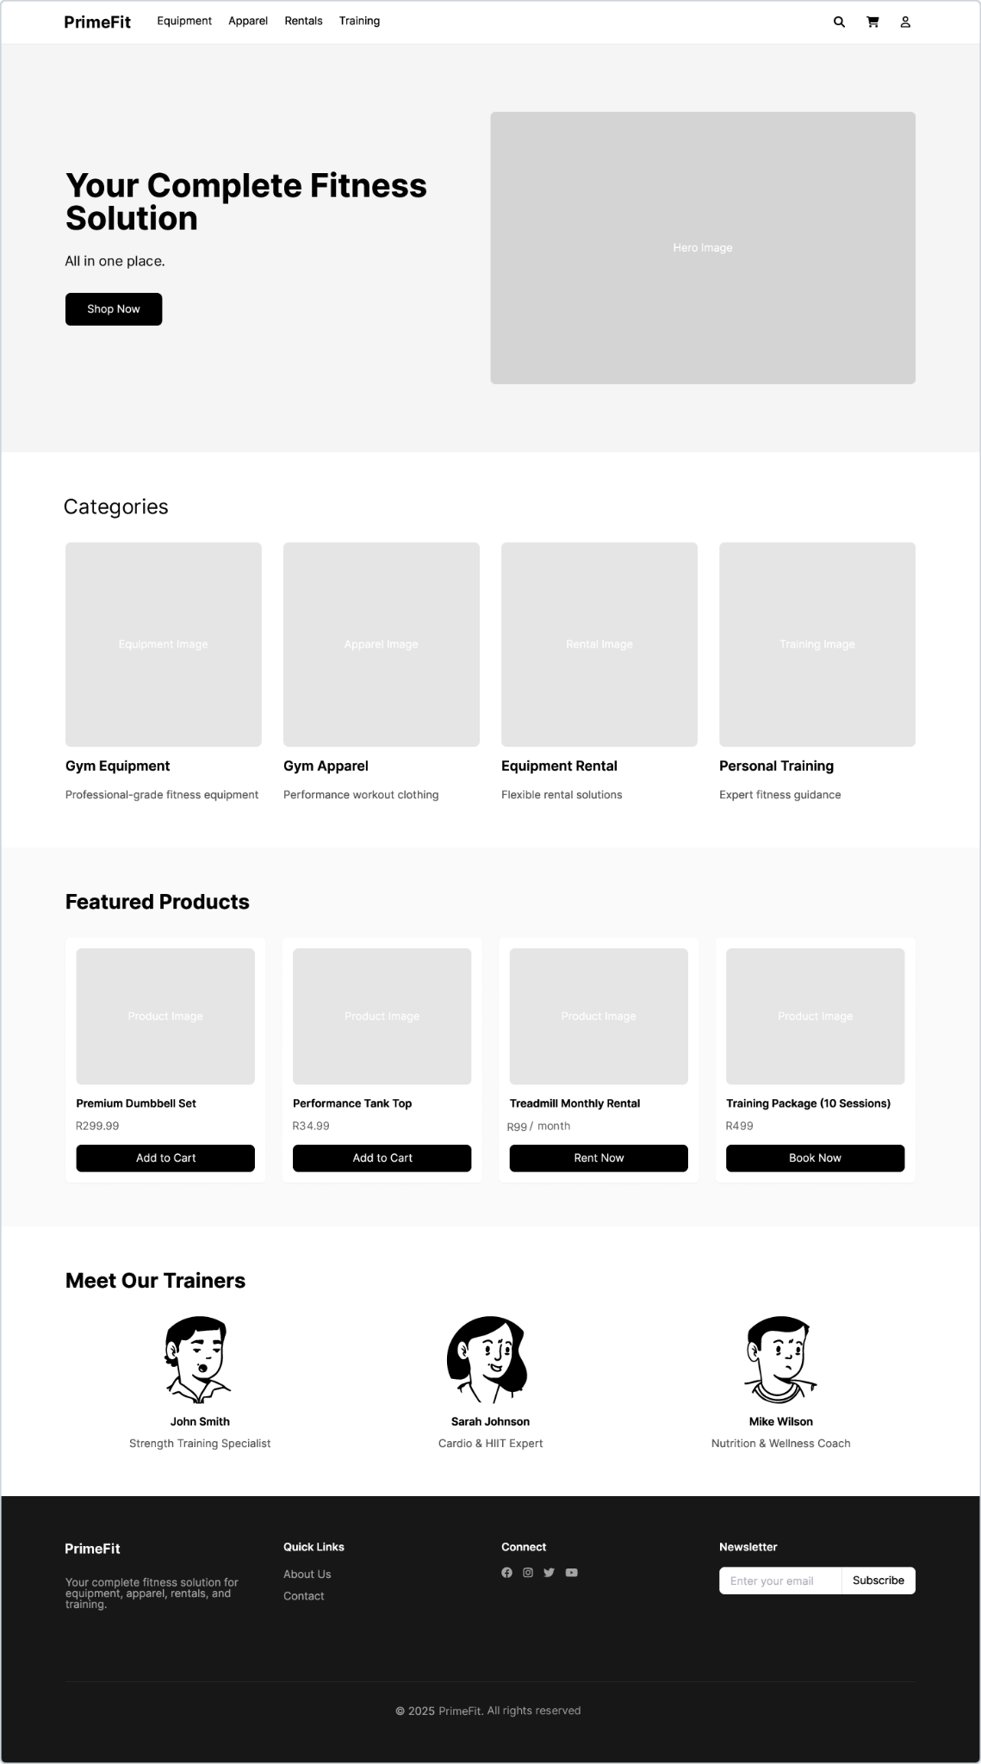
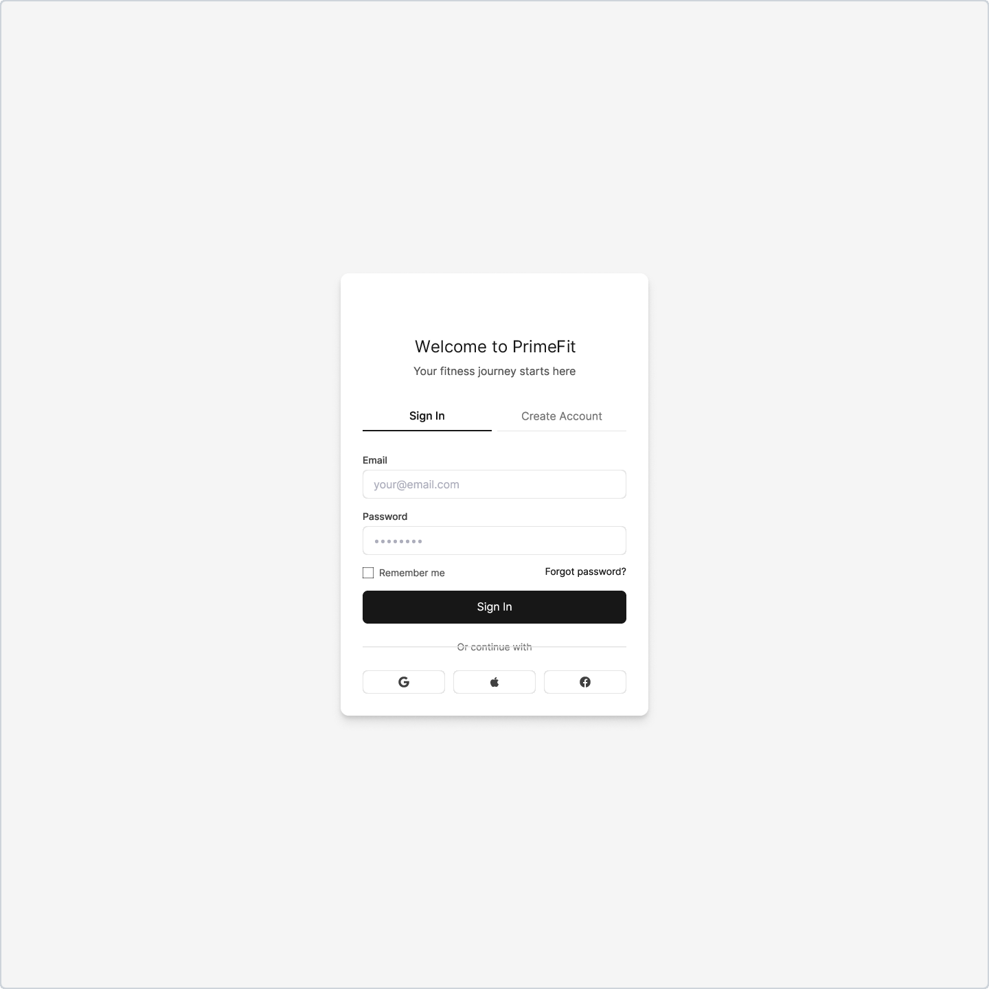
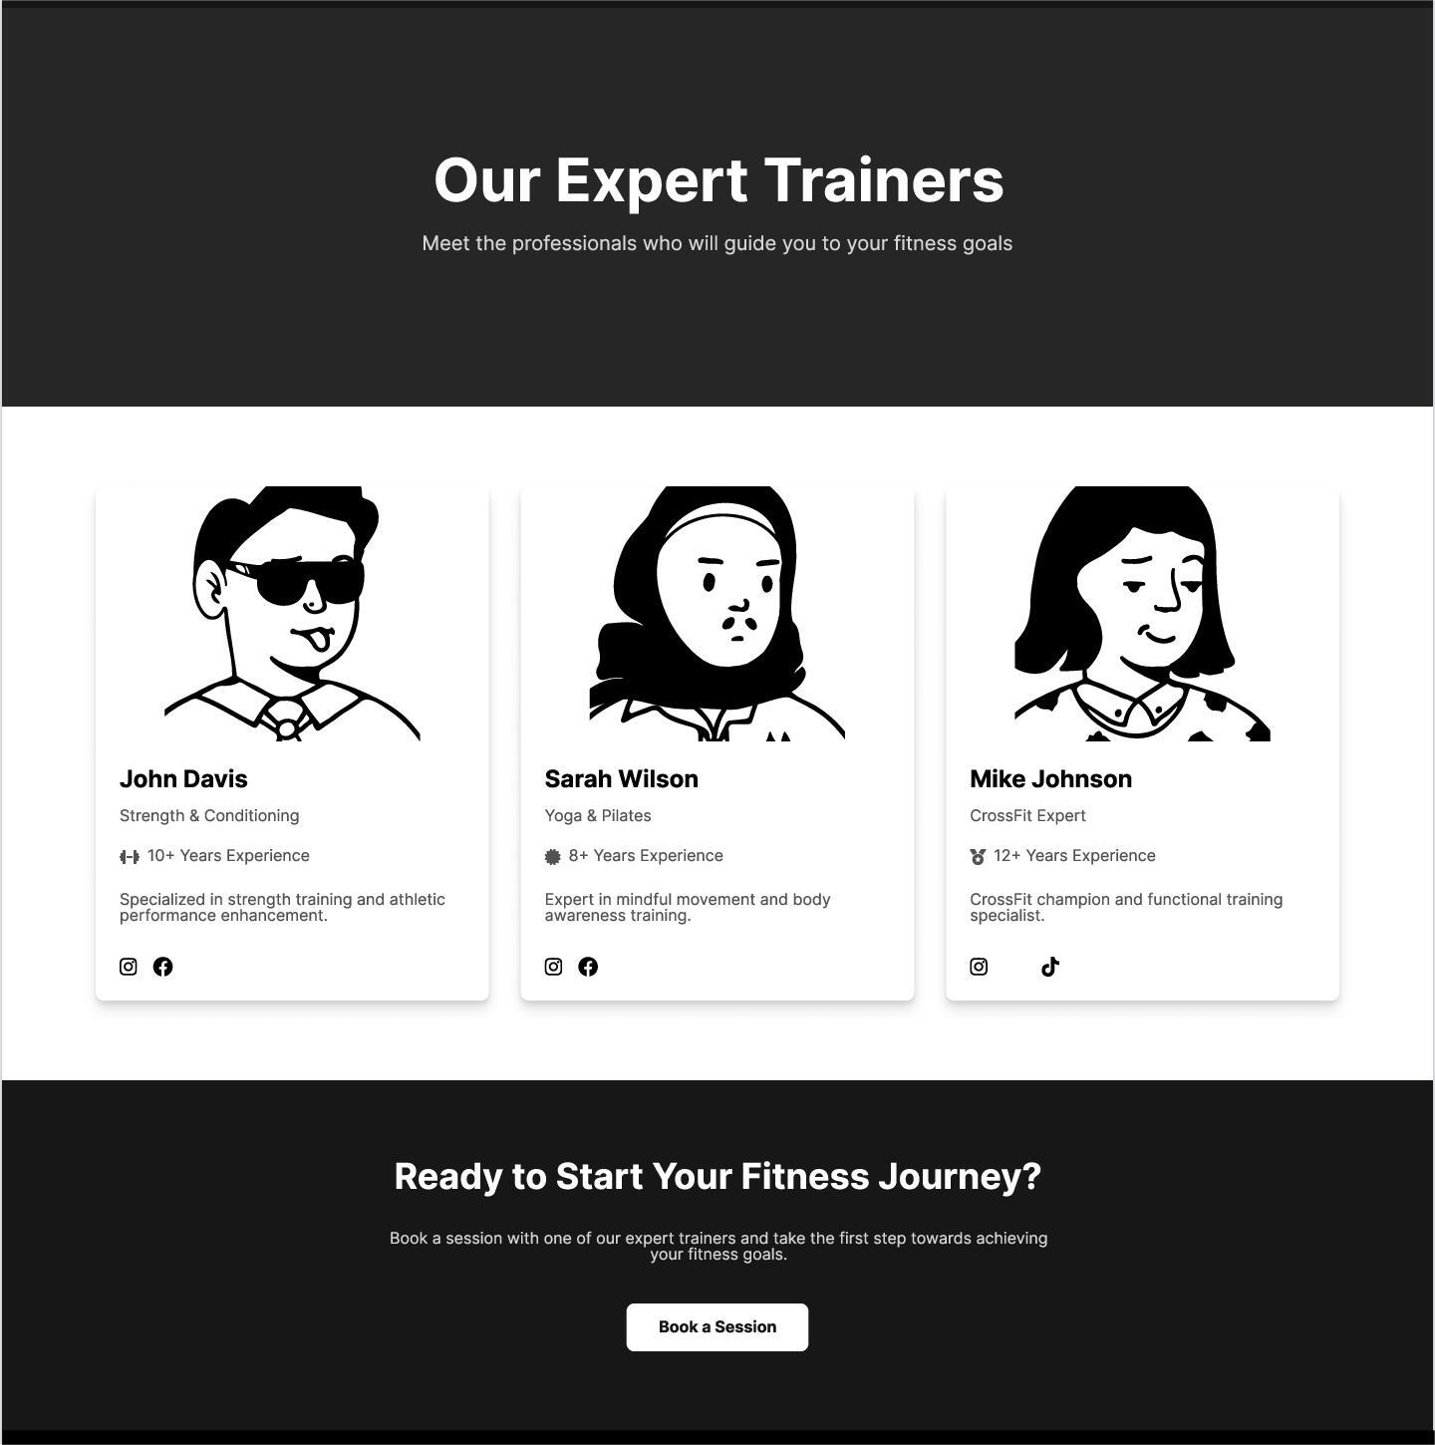
UI/UX Design & Wireframes

Slide 9
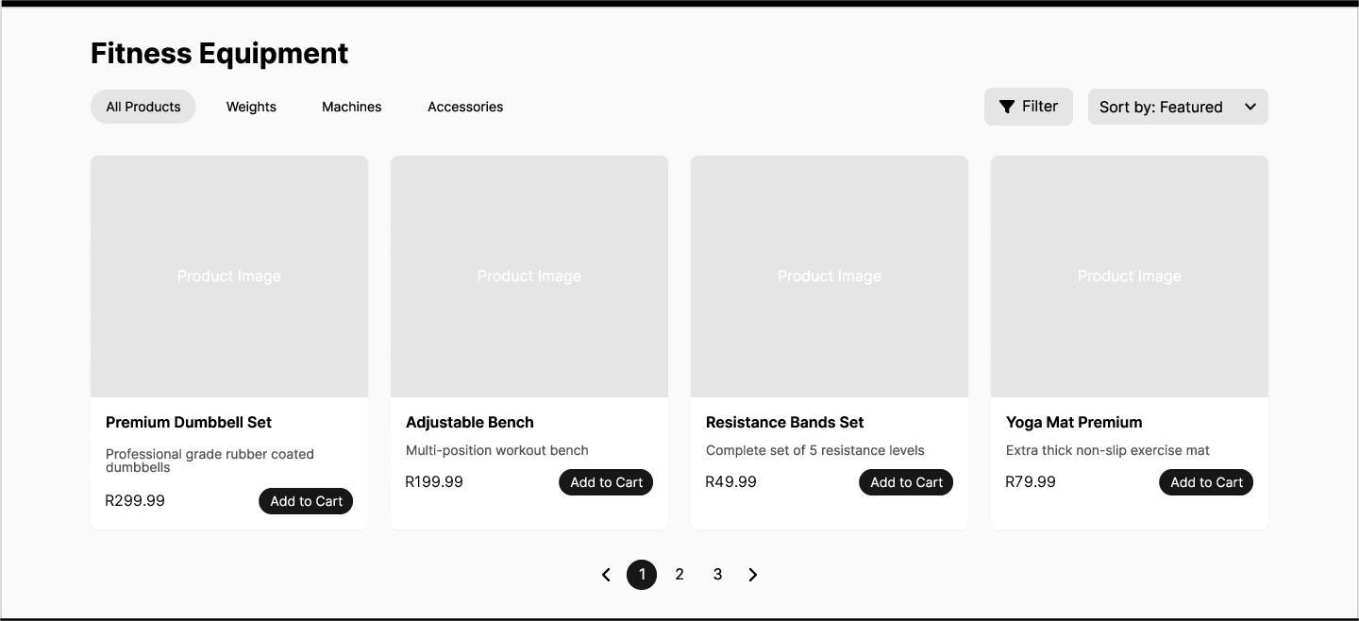

Slide 10


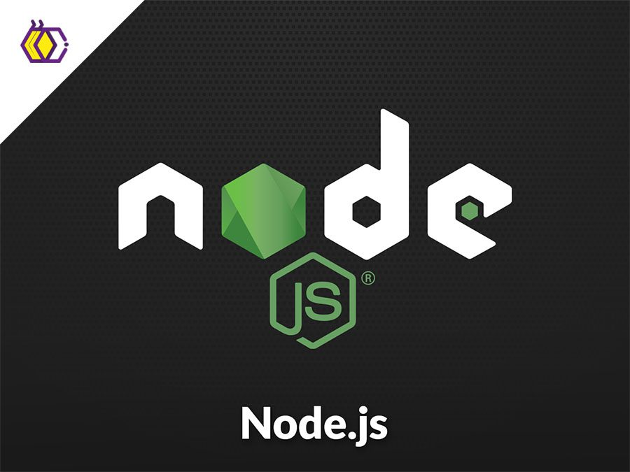
Technical Features & Functionality
Tech Stack:
MySQL (Database)
Node.js (Backend/API)
Vue.js (Frontend)

Slide 11
Technical Features & Functionality
Key functionalities:
✅ User authentication & personalized dashboard
✅ Subscription & payment integration
✅ Search & filtering for workout videos, articles, and products
✅ Trainer booking system

Slide 12
Proceed To Website Demo
Do some push-ups while you wait…

Slide 13
PrimeFit
Fitness not only at your doorstep, but in your homes.
Questions?

